Slide 1




Tree and Graph Traversal Algorithms
Breadth-First Search (BFS) and Depth-First-Search (DFS)
DFS and BFS
SoftUni Team
Technical Trainers
Software University
http://softuni.bg

Slide 2

Table of Contents
Traversing Tree-Like Structures
Depth-First Search (DFS)
Recursive implementation
Stack-based implementation
Breadth-First Search (BFS)
Queue-based implementation

Slide 3
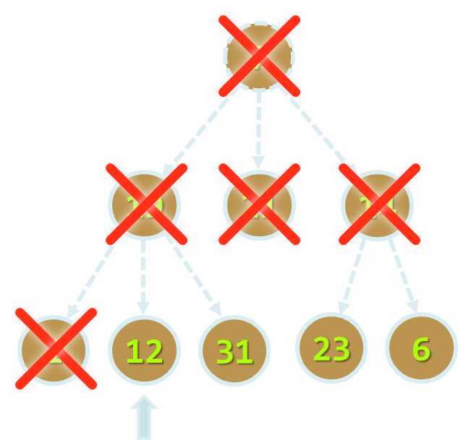
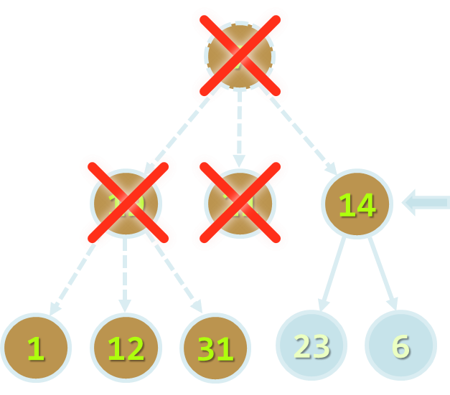
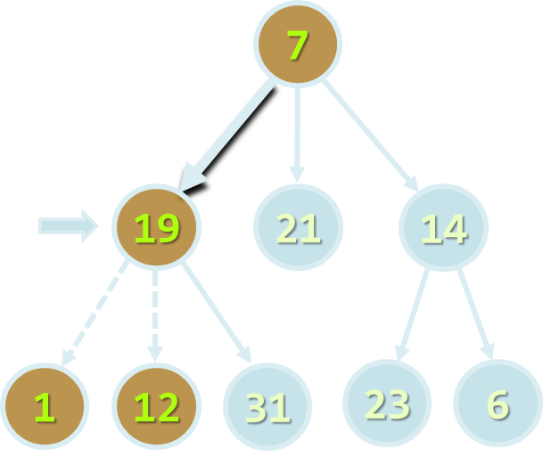
Traversing Tree-Like Structures
DFS and BFS Traversals

Slide 4
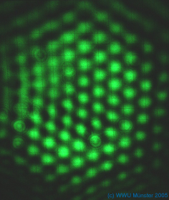
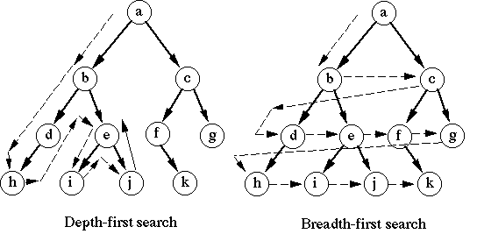
Tree Traversal Algorithms
Traversing a tree means to visit each of its nodes exactly once
The order of visiting nodes may vary on the traversal algorithm
Depth-First Search (DFS)
Visit node's successors first
Usually implemented by recursion
Breadth-First Search (BFS)
Nearest nodes visited first
Implemented by a queue

Slide 5
Depth-First Search (DFS)
Depth-First Search (DFS) first visits all descendants of given node recursively, finally visits the node itself
DFS algorithm pseudo code:
9
7
DFS (node)
{
for each child c of node
DFS(c);
print node;
}
4
19
5
21
8
14
1
2
3
6
7
1
12
31
23
6

Slide 6
DFS in Action (Step 1)
Stack: 7
Output: (empty)
Start DFS from the tree root
7
19
21
14
1
12
31
23
6

Slide 7
DFS in Action (Step 2)
Stack: 7, 19
Output: (empty)
Enter recursively into the first child
7
19
21
14
1
12
31
23
6

Slide 8
DFS in Action (Step 3)
Stack: 7, 19, 1
Output: (empty)
Enter recursively into the first child
7
19
21
14
1
12
31
23
6

Slide 9
DFS in Action (Step 4)
Stack: 7, 19
Output: 1
Return back from recursion and print the last visited node
7
19
21
14
1
12
31
23
6

Slide 10
DFS in Action (Step 5)
Stack: 7, 19, 12
Output: 1
Enter recursively into the first child
7
19
21
14
1
12
31
23
6

Slide 11
DFS in Action (Step 6)
Stack: 7, 19
Output: 1, 12
Return back from recursion and print the last visited node
7
19
21
14
1
12
31
23
6

Slide 12
DFS in Action (Step 7)
Stack: 7, 19, 31
Output: 1, 12
Enter recursively into the first child
7
19
21
14
1
12
31
23
6

Slide 13
DFS in Action (Step 8)
Stack: 7, 19
Output: 1, 12, 31
Return back from recursion and print the last visited node
7
19
21
14
1
12
31
23
6

Slide 14
DFS in Action (Step 9)
Stack: 7
Output: 1, 12, 31, 19
Return back from recursion and print the last visited node
7
19
21
14
1
12
31
23
6

Slide 15
DFS in Action (Step 10)
Stack: 7, 21
Output: 1, 12, 31, 19
Enter recursively into the first child
7
19
21
14
1
12
31
23
6

Slide 16
DFS in Action (Step 11)
Stack: 7
Output: 1, 12, 31, 19, 21
Return back from recursion and print the last visited node
7
19
21
14
1
12
31
23
6

Slide 17
DFS in Action (Step 12)
Stack: 7, 14
Output: 1, 12, 31, 19, 21
Enter recursively into the first child
7
19
21
14
1
12
31
23
6

Slide 18
DFS in Action (Step 13)
Stack: 7, 14, 23
Output: 1, 12, 31, 19, 21
Enter recursively into the first child
7
19
21
14
1
12
31
23
6

Slide 19
DFS in Action (Step 14)
Stack: 7, 14
Output: 1, 12, 31, 19, 21, 23
Return back from recursion and print the last visited node
7
19
21
14
1
12
31
23
6

Slide 20
DFS in Action (Step 15)
Stack: 7, 14, 6
Output: 1, 12, 31, 19, 21, 23
Enter recursively into the first child
7
19
21
14
1
12
31
23
6

Slide 21
DFS in Action (Step 16)
Stack: 7, 14
Output: 1, 12, 31, 19, 21, 23, 6
Return back from recursion and print the last visited node
7
19
21
14
1
12
31
23
6

Slide 22
DFS in Action (Step 17)
Stack: 7
Output: 1, 12, 31, 19, 21, 23, 6, 14
Return back from recursion and print the last visited node
7
19
21
14
1
12
31
23
6

Slide 23
DFS in Action (Step 18)
Stack: (empty)
Output: 1, 12, 31, 19, 21, 23, 6, 14, 7
DFS traversal finished
7
19
21
14
1
12
31
23
6

Slide 24
Depth-First Search (DFS) for Graphs
The DFS algorithm for graph traversals should visit each node exactly once → it should track all visited / unvisited nodes:
visited[0 … n-1] = false;
for (v = 0 … n-1) DFS(v)
DFS (node)
{
if not visited[node] {
visited[node] = true;
for each child c of node
DFS(c);
print node;
}
}
0
6
3
1
4
5
7
8
2

Slide 25
Lab Exercise
0
6
0
0
7
3
1
2
1
2
1
6
4
5
7
3
5
3
4
8
2
Find the Connected Components in a Graph with DFS

Slide 26
Breadth-First Search (BFS)
Breadth-First Search (BFS) first visits the neighbor nodes, then the neighbors of neighbors, etc.
BFS algorithm pseudo code:
1
7
BFS (node)
{
queue ← node
while queue not empty
v ← queue
print v
for each child c of v
queue ← c
}
2
19
3
21
4
14
5
6
7
8
9
1
12
31
23
6

Slide 27
BFS in Action (Step 1)
Queue: 7
Output:
Initially enqueue the root node
7
19
21
14
1
12
31
23
6

Slide 28
BFS in Action (Step 2)
Queue: 7
Output: 7
Remove from the queue the next node and print it
7
19
21
14
1
12
31
23
6

Slide 29
BFS in Action (Step 3)
Queue: 7, 19
Output: 7
Enqueue all children of the current node
7
19
21
14
1
12
31
23
6

Slide 30
BFS in Action (Step 4)
Queue: 7, 19, 21
Output: 7
Enqueue all children of the current node
7
19
21
14
1
12
31
23
6

Slide 31
BFS in Action (Step 5)
Queue: 7, 19, 21, 14
Output: 7
Enqueue all children of the current node
7
19
21
14
1
12
31
23
6

Slide 32
BFS in Action (Step 6)
Queue: 7, 19, 21, 14
Output: 7, 19
Remove from the queue the next node and print it
7
19
21
14
1
12
31
23
6

Slide 33
BFS in Action (Step 7)
Queue: 7, 19, 21, 14, 1
Output: 7, 19
Enqueue all children of the current node
7
19
21
14
1
12
31
23
6

Slide 34
BFS in Action (Step 8)
Queue: 7, 19, 21, 14, 1, 12
Output: 7, 19
Enqueue all children of the current node
7
19
21
14
1
12
31
23
6

Slide 35
BFS in Action (Step 9)
Queue: 7, 19, 21, 14, 1, 12, 31
Output: 7, 19
Enqueue all children of the current node
7
19
21
14
1
12
31
23
6

Slide 36
BFS in Action (Step 10)
Queue: 7, 19, 21, 14, 1, 12, 31
Output: 7, 19, 21
Remove from the queue the next node and print it
7
19
21
14
No child nodes to enqueue
1
12
31
23
6

Slide 37
BFS in Action (Step 11)
Queue: 7, 19, 21, 14, 1, 12, 31
Output: 7, 19, 21, 14
Remove from the queue the next node and print it
7
19
21
14
1
12
31
23
6

Slide 38
BFS in Action (Step 12)
Queue: 7, 19, 21, 14, 1, 12, 31, 23
Output: 7, 19, 21, 14
Enqueue all children of the current node
7
19
21
14
1
12
31
23
6

Slide 39
BFS in Action (Step 13)
Queue: 7, 19, 21, 14, 1, 12, 31, 23, 6
Output: 7, 19, 21, 14
Enqueue all children of the current node
7
19
21
14
1
12
31
23
6

Slide 40
BFS in Action (Step 14)
Queue: 7, 19, 21, 14, 1, 12, 31, 23, 6
Output: 7, 19, 21, 14, 1
Remove from the queue the next node and print it
7
19
21
14
No child nodes to enqueue
1
12
31
23
6

Slide 41
BFS in Action (Step 15)
Queue: 7, 19, 21, 14, 1, 12, 31, 23, 6
Output: 7, 19, 21, 14, 1, 12
Remove from the queue the next node and print it
7
19
21
14
No child nodes to enqueue
1
12
31
23
6

Slide 42
BFS in Action (Step 16)
Queue: 7, 19, 21, 14, 1, 12, 31, 23, 6
Output: 7, 19, 21, 14, 1, 12, 31
Remove from the queue the next node and print it
7
19
21
14
No child nodes to enqueue
1
12
31
23
6

Slide 43
BFS in Action (Step 17)
Queue: 7, 19, 21, 14, 1, 12, 31, 23, 6
Output: 7, 19, 21, 14, 1, 12, 31, 23
Remove from the queue the next node and print it
7
19
21
14
No child nodes to enqueue
1
12
31
23
6

Slide 44
BFS in Action (Step 18)
Queue: 7, 19, 21, 14, 1, 12, 31, 23, 6
Output: 7, 19, 21, 14, 1, 12, 31, 23, 6
Remove from the queue the next node and print it
7
19
21
14
No child nodes to enqueue
1
12
31
23
6

Slide 45
BFS in Action (Step 19)
Queue: 7, 19, 21, 14, 1, 12, 31, 23, 6
Output: 7, 19, 21, 14, 1, 12, 31, 23, 6
The queue is empty → stop
7
19
21
14
1
12
31
23
6

Slide 46
Exit from Labyrinth
We are given a labyrinth
We start from a cell 's'
We can move left, right, up and down, through empty space '-'
We cannot pass through walls '*'
An exit is found when a cell on a labyrinth side is reached
* | * | * | * | * | * | * | * | *
* | - | - | - | - | * | * | - | -
* | * | - | * | - | - | - | - | *
* | - | - | * | - | * | - | * | *
* | s | * | - | - | * | - | * | *
* | * | - | - | - | - | - | - | *
* | * | * | * | * | * | * | - | *

Slide 47
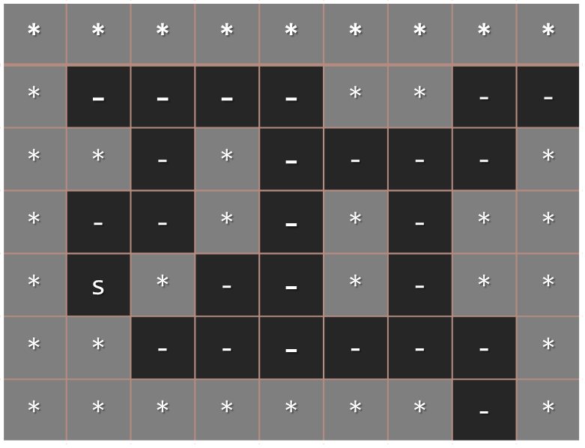
Lab Exercise
Find the Nearest Exit from a Labyrinth with BFS

Slide 48
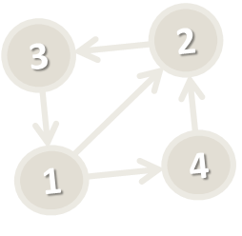
DFS Applications
Where is DFS used?
Finding connected components in a graph
Topological sorting
Detecting cycles in a graph
Finding exit from maze
A
F
O
C
D
H
G
Connected components
IDEs
conditionals
variables
loops
bits
Detecting cycles in a graph
Topological sorting of course topics

Slide 49
BFS Applications
14
Where is BFS used?
Finding the shortest distance
E.g. Dijkstra's Algorithm
Finding the minimal spanning tree
Equally distributing problems
E.g. Web crawler traversal
A
17
F
J
10
6
13
11
16
K
D
33
G
26
12
4
9
20
E
14
C
22
H
Minimal spanning tree
17
4
20
6
1
10
6
5
11
6
5
s
0
5
33
11
26
9
12
3
9
20
3
8
14
2
15
7
Shortest path (from 0 to 9)

Slide 50
Iterative DFS and BFS
What will happen if in the Breadth-First Search (BFS) algorithm we change the queue with a stack?
An iterative stack-based Depth-First Search (DFS)
BFS (node)
{
queue ← node
while queue not empty
v ← queue
print v
for each child c of v
queue ← c
}
DFS (node)
{
stack ← node
while stack not empty
v ← stack
print v
for each child c of v
stack ← c
}

Slide 51

Summary
Tree / graph traversal algorithms:
Depth-First Search (DFS)
Breadth-First Search (BFS)
DFS algorithm
Use recursion: traverse a node and recursively its child nodes
BFS algorithm
Use a queue: while not empty -> dequeue a node and enqueue its descendent nodes

Slide 52








Tree and Graph Traversal Algorithms
https://softuni.bg/trainings/1308/data-structures-february-2016

Slide 53
License
This course (slides, examples, labs, videos, homework, etc.) is licensed under the "Creative Commons Attribution-NonCommercial-ShareAlike 4.0 International" license
Attribution: this work may contain portions from
"Fundamentals of Computer Programming with C#" book by Svetlin Nakov & Co. under CC-BY-SA license
"Data Structures and Algorithms" course by Telerik Academy under CC-BY-NC-SA license

Slide 54






Free Trainings @ Software University
Software University Foundation – softuni.org
Software University – High-Quality Education, Profession and Job for Software Developers
softuni.bg
Software University @ Facebook
facebook.com/SoftwareUniversity
Software University @ YouTube
youtube.com/SoftwareUniversity
Software University Forums – forum.softuni.bg

